Slide 1
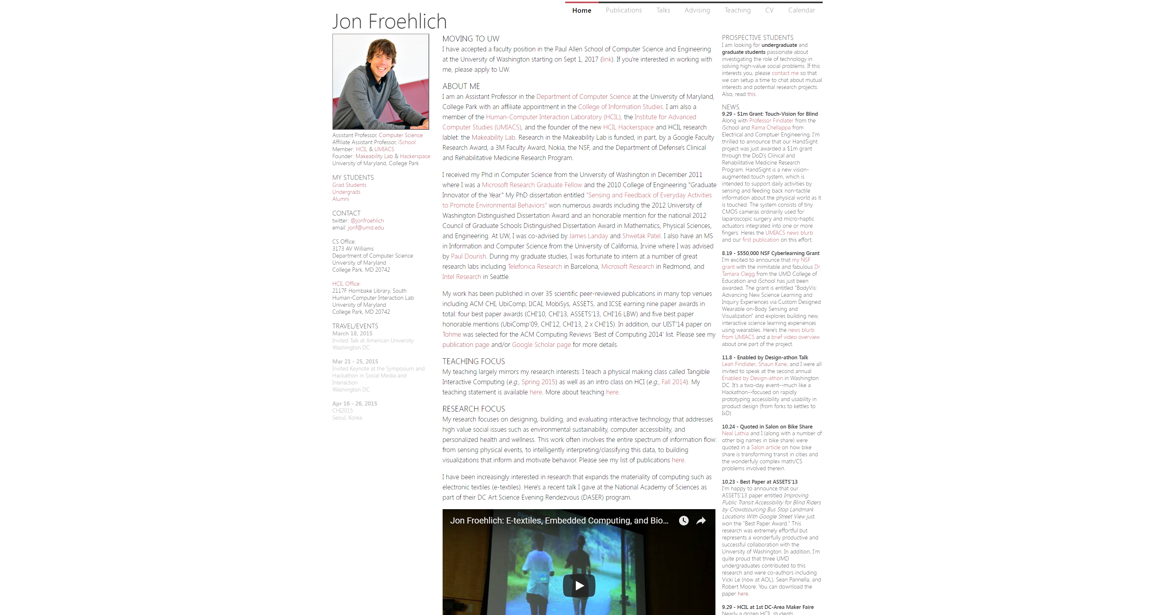

Slide 2


Slide 3

Notes:
https://chuanenl.in/

Slide 4
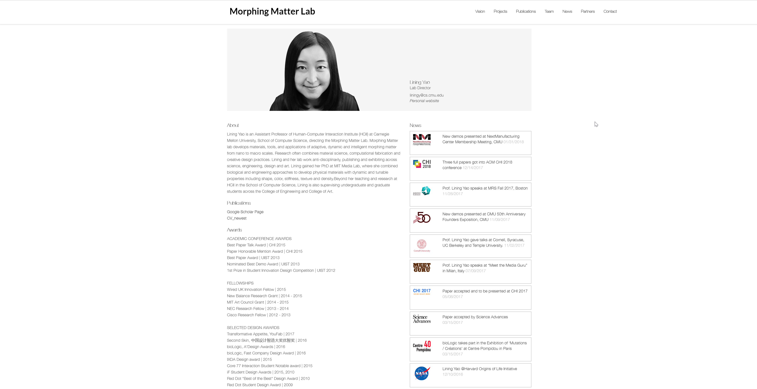
Notes:
http://morphingmatter.cs.cmu.edu/lining-yao/

Slide 5
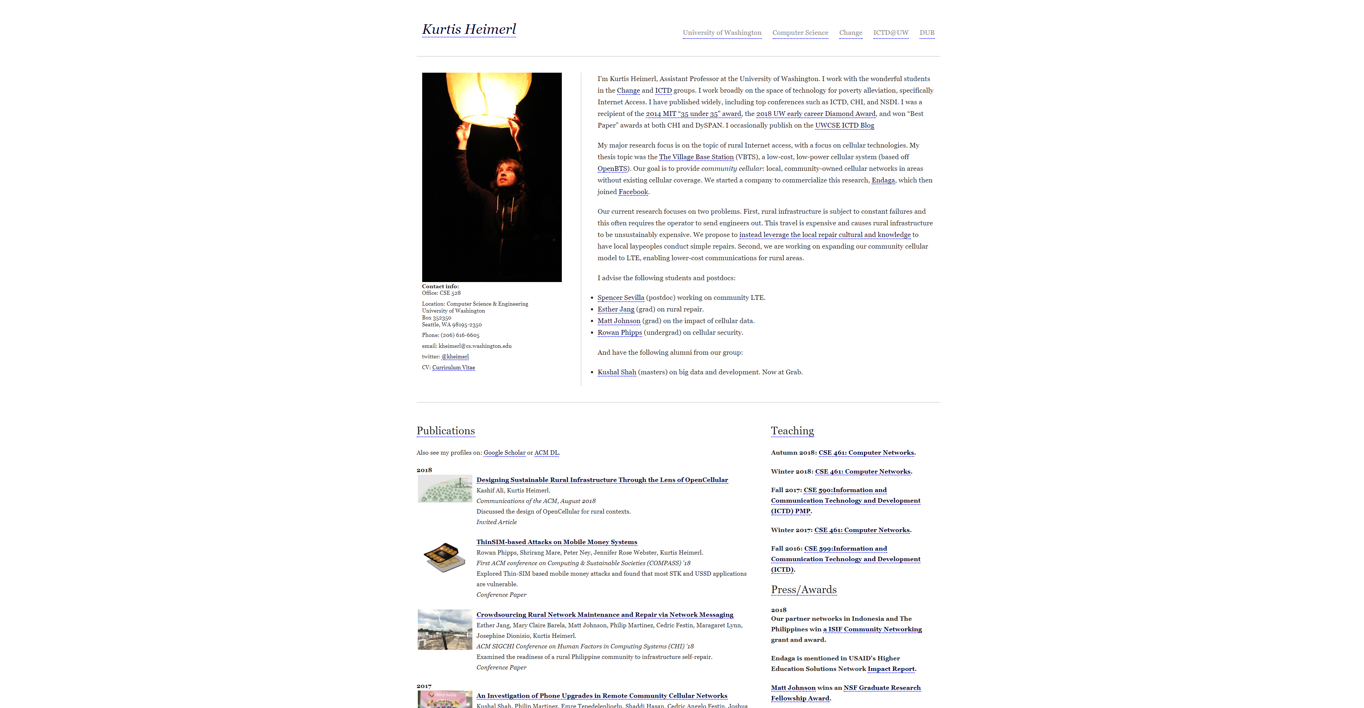

Slide 6
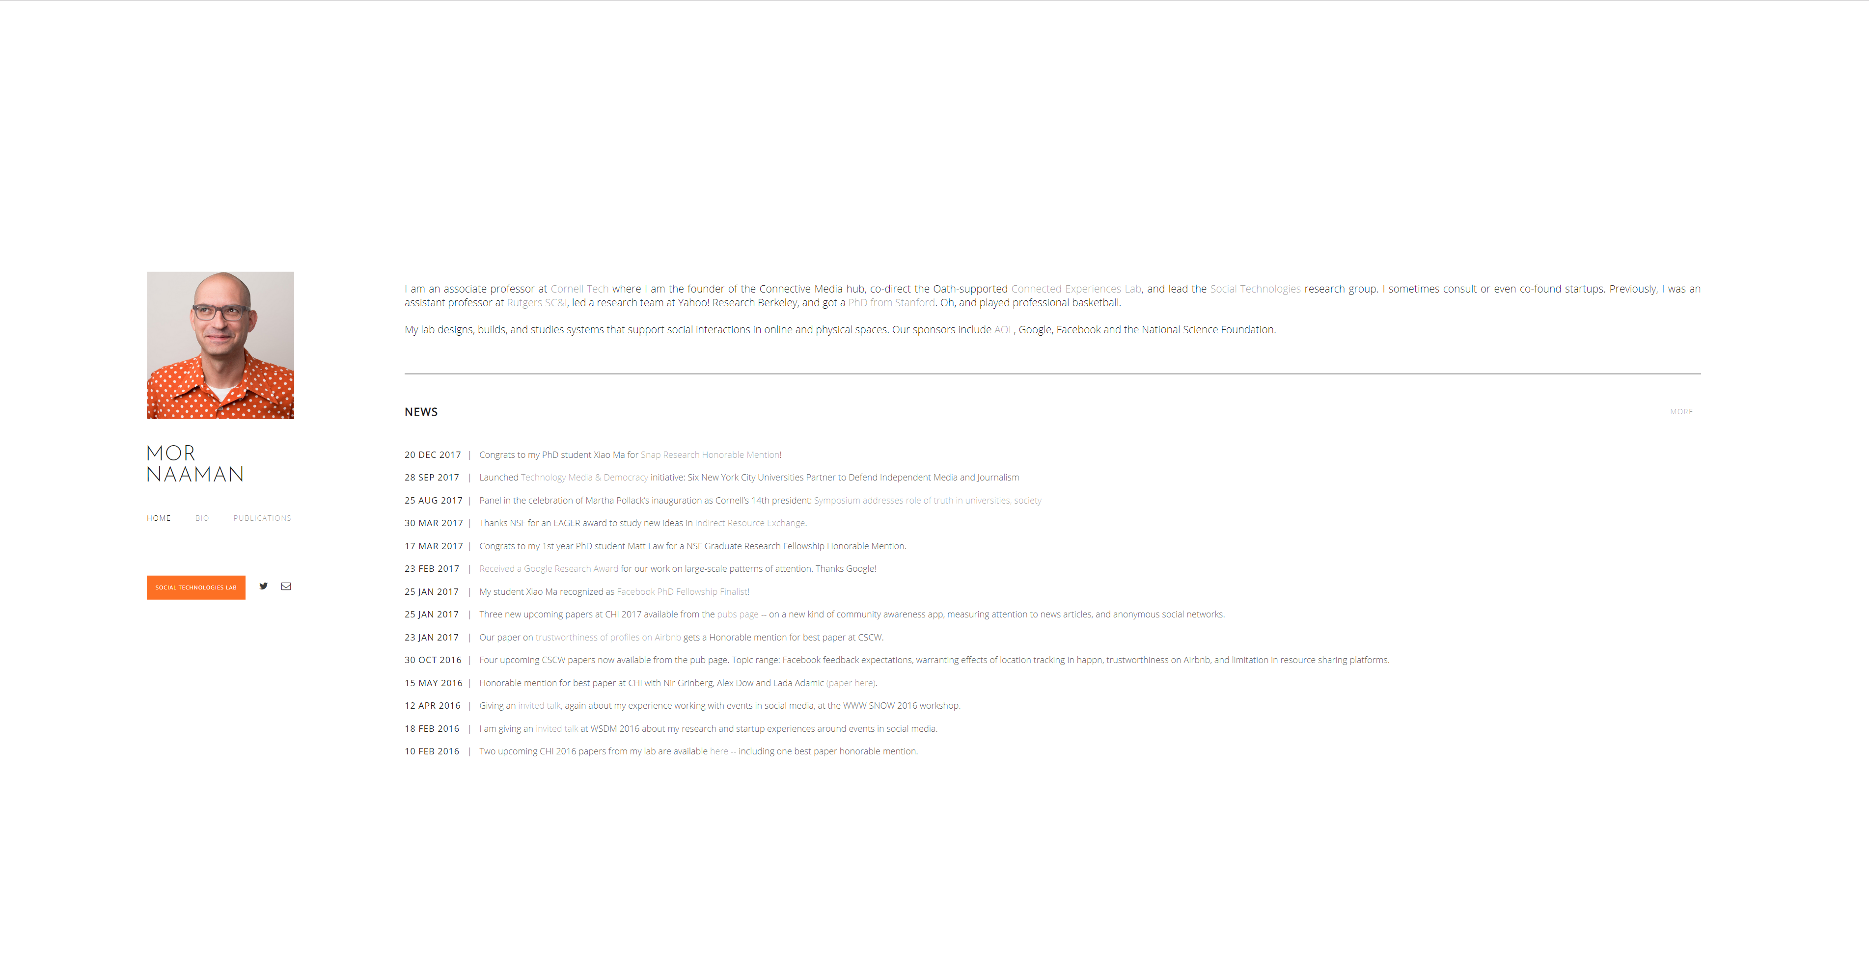
Notes:
https://people.jacobs.cornell.edu/mor/

Slide 7
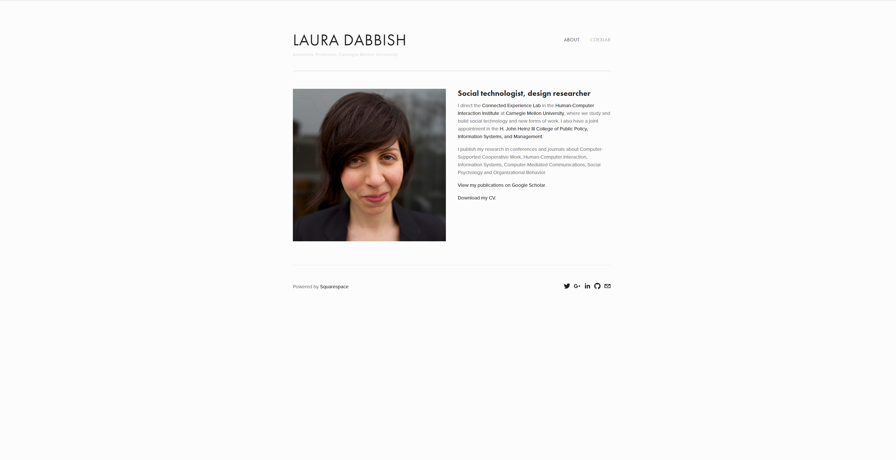
Notes:
http://www.lauradabbish.com/

Slide 8
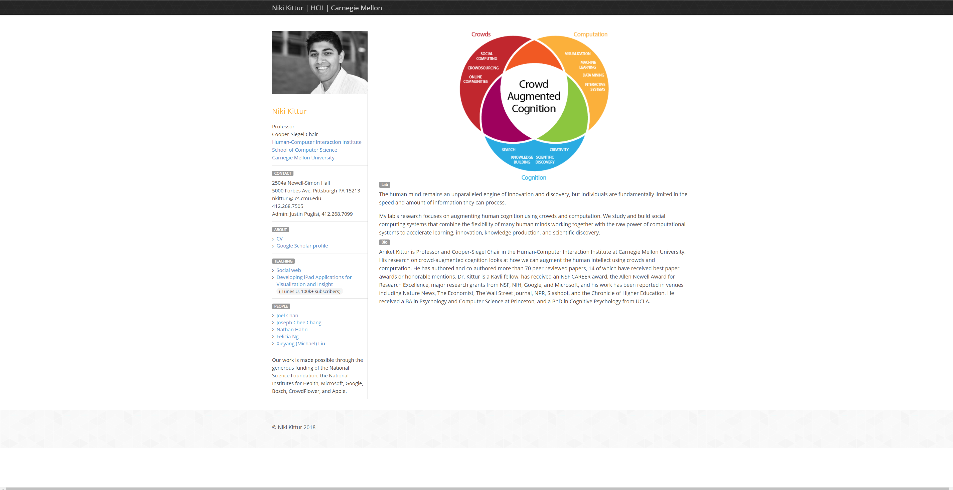
Notes:
http://kittur.org/

Slide 9
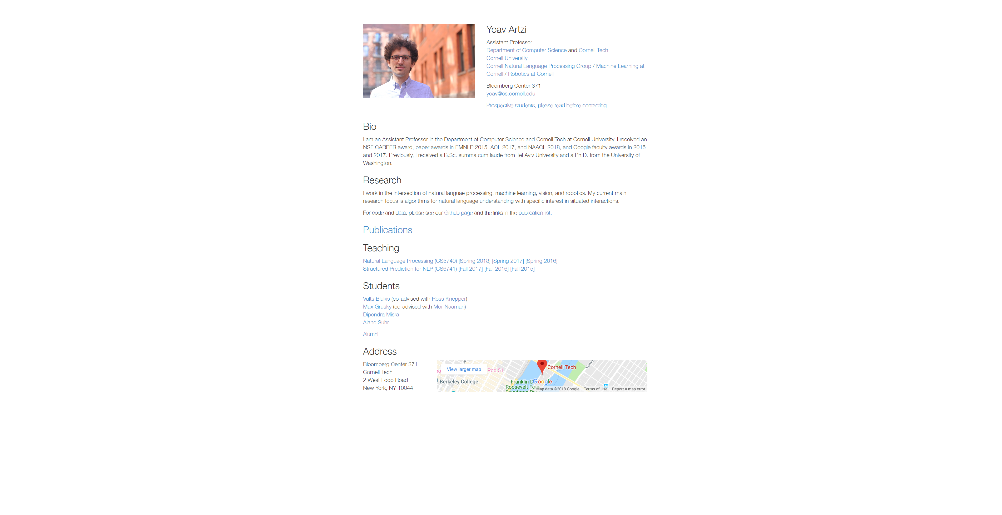

Slide 10
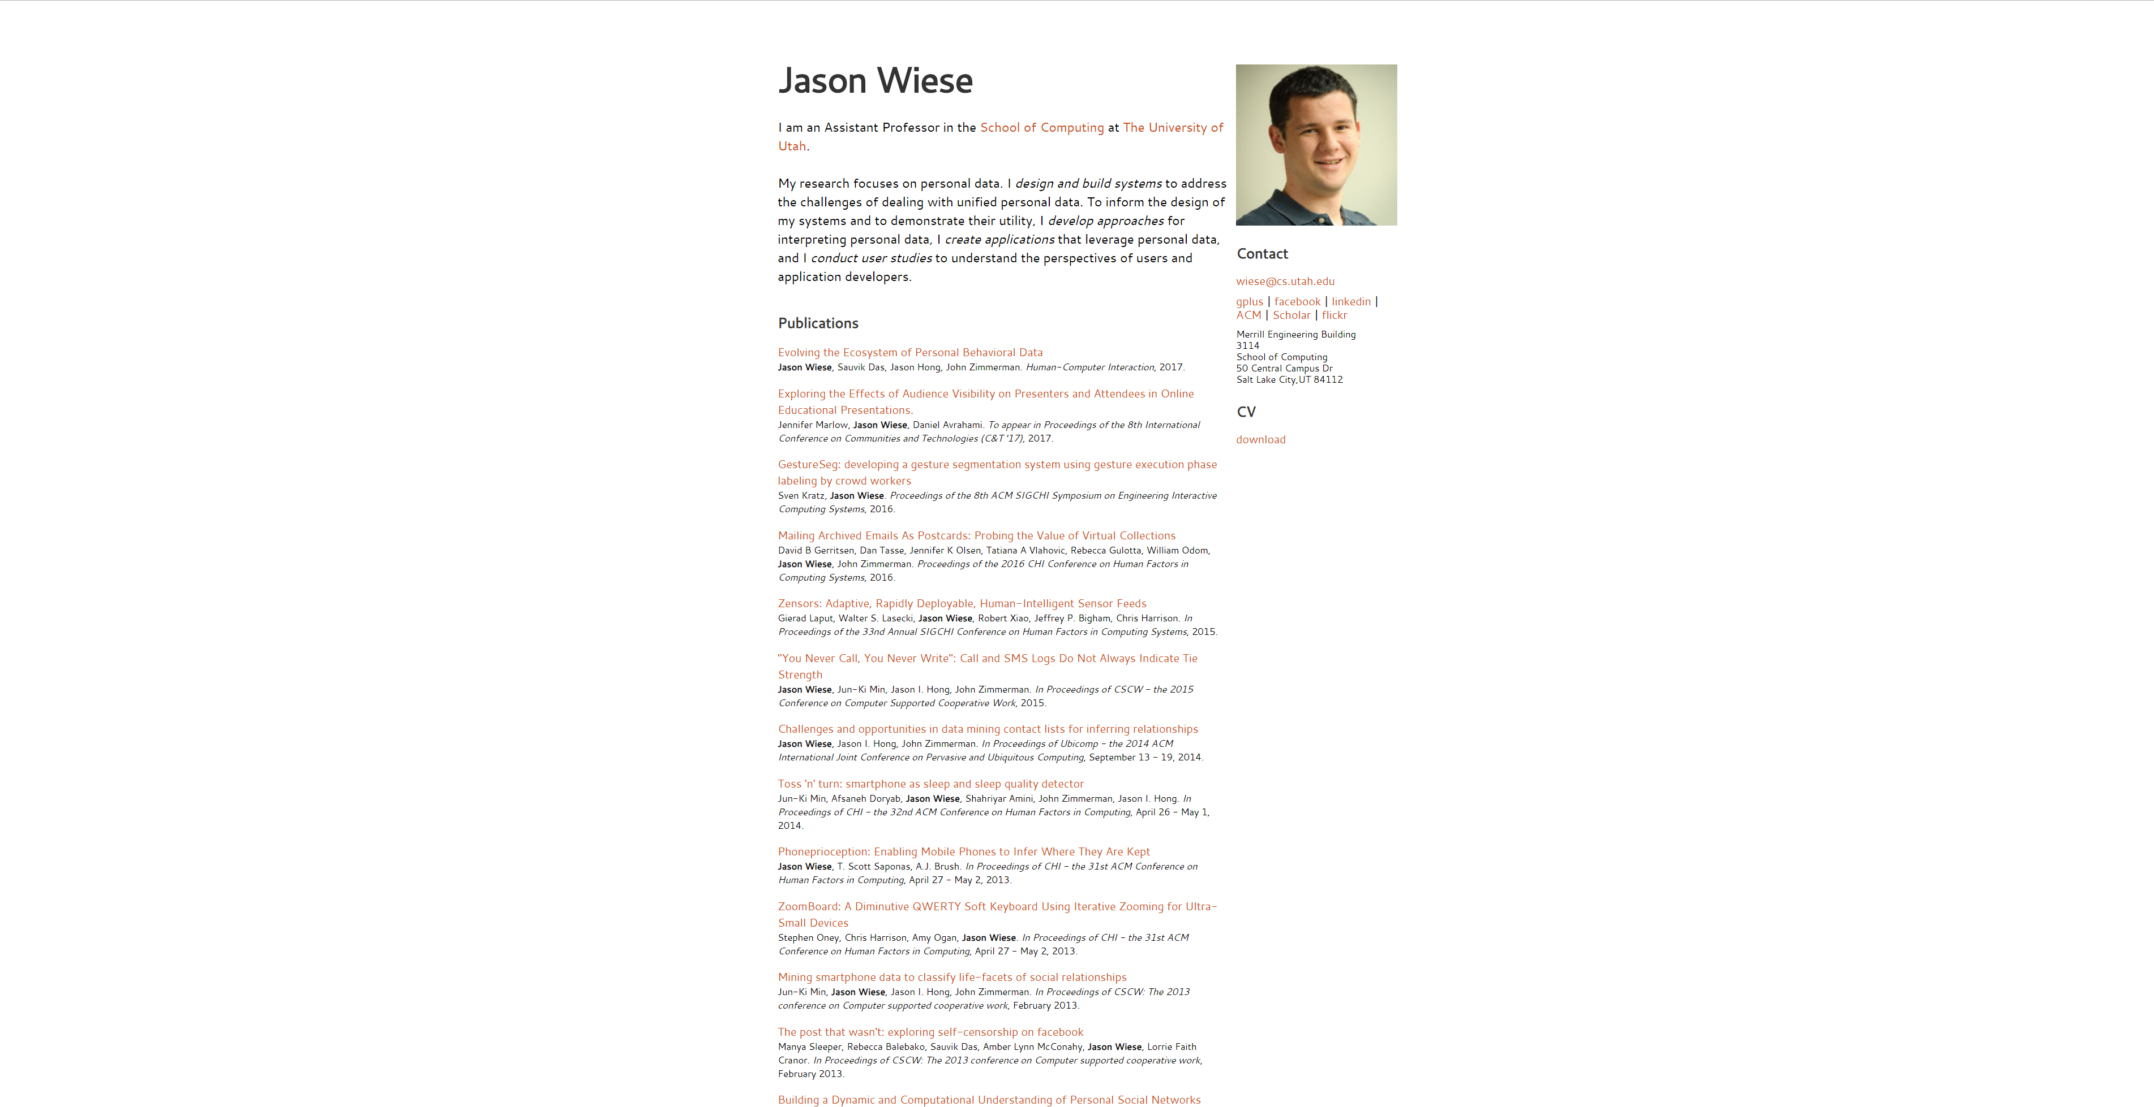

Slide 11
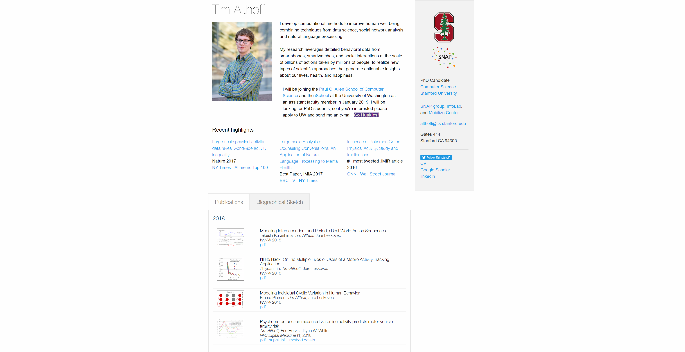
Notes:
http://timalthoff.de/

Slide 12
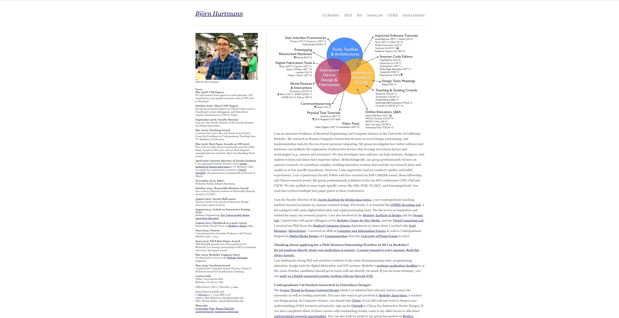

Slide 13
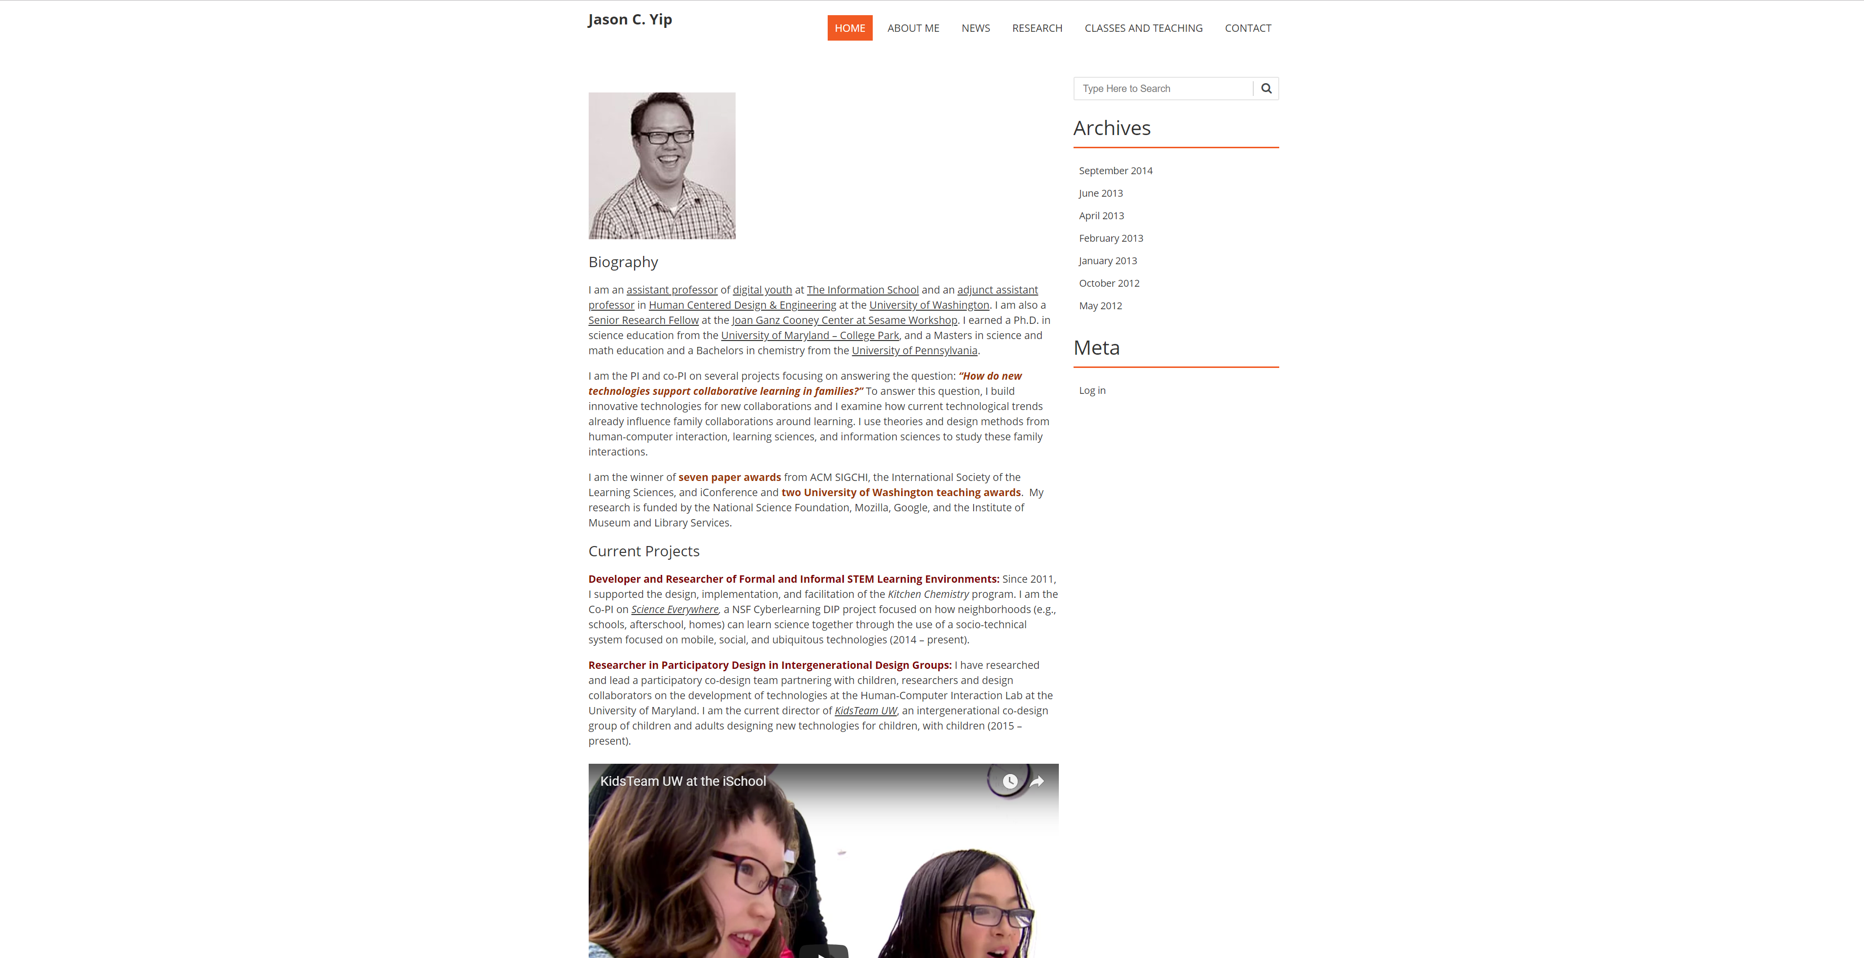

Slide 14
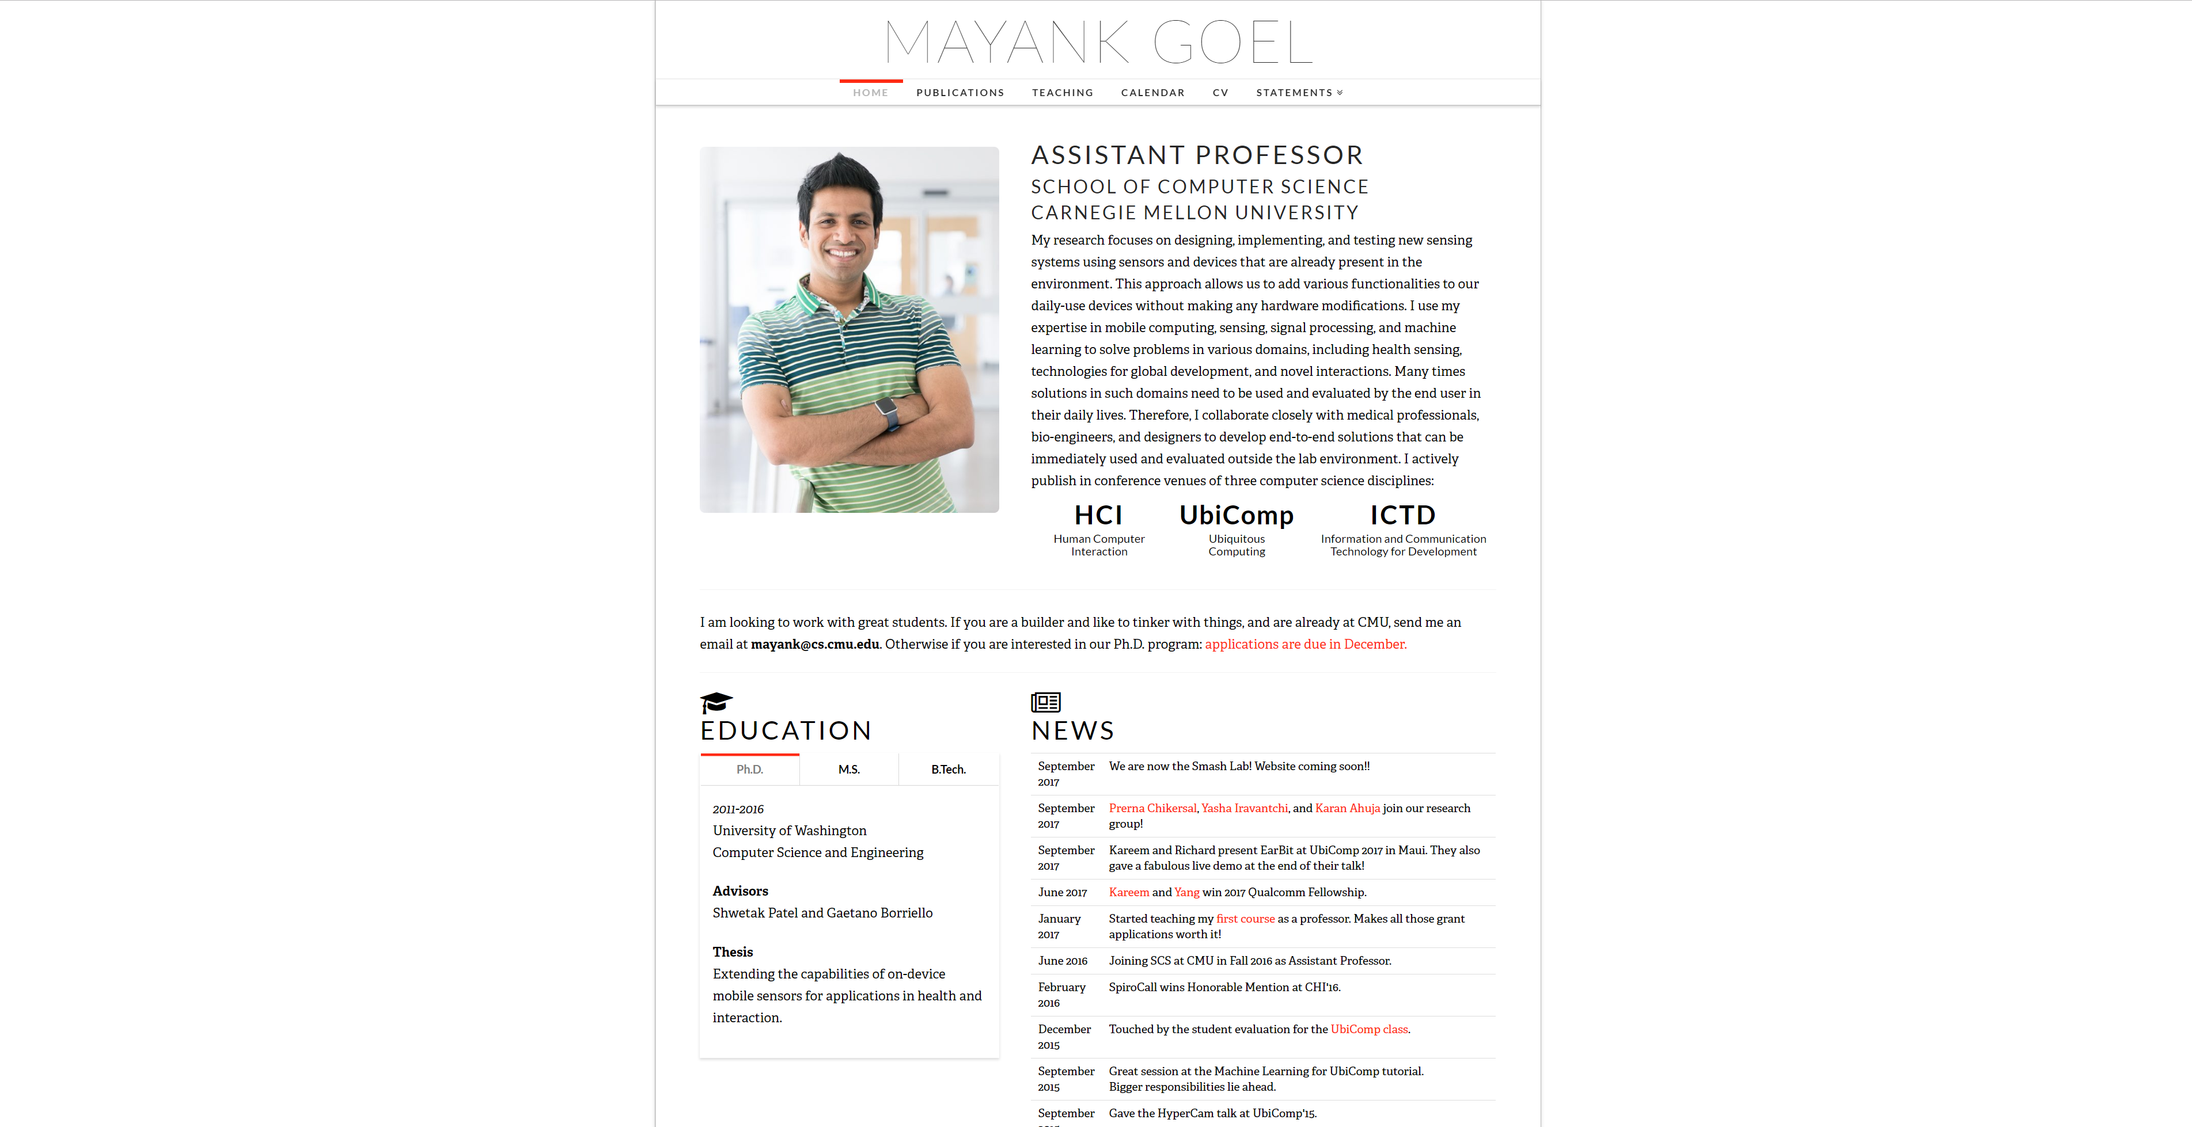
Notes:
http://www.mayankgoel.courses/

Slide 15
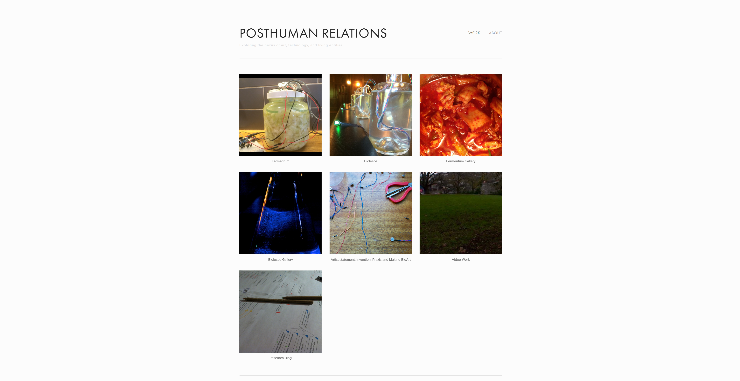
Notes:
Tyler Fox: http://www.tylersfox.com/

Slide 16

Notes:
https://www.wxwangdesign.com/

Slide 17
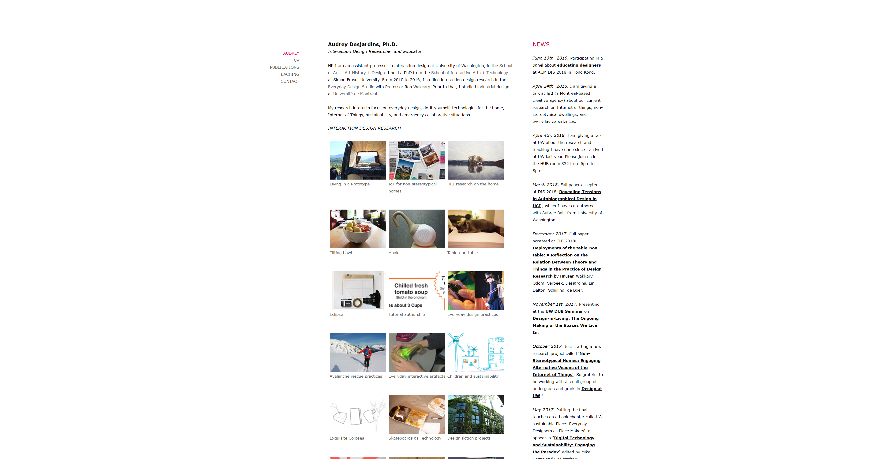

Slide 18
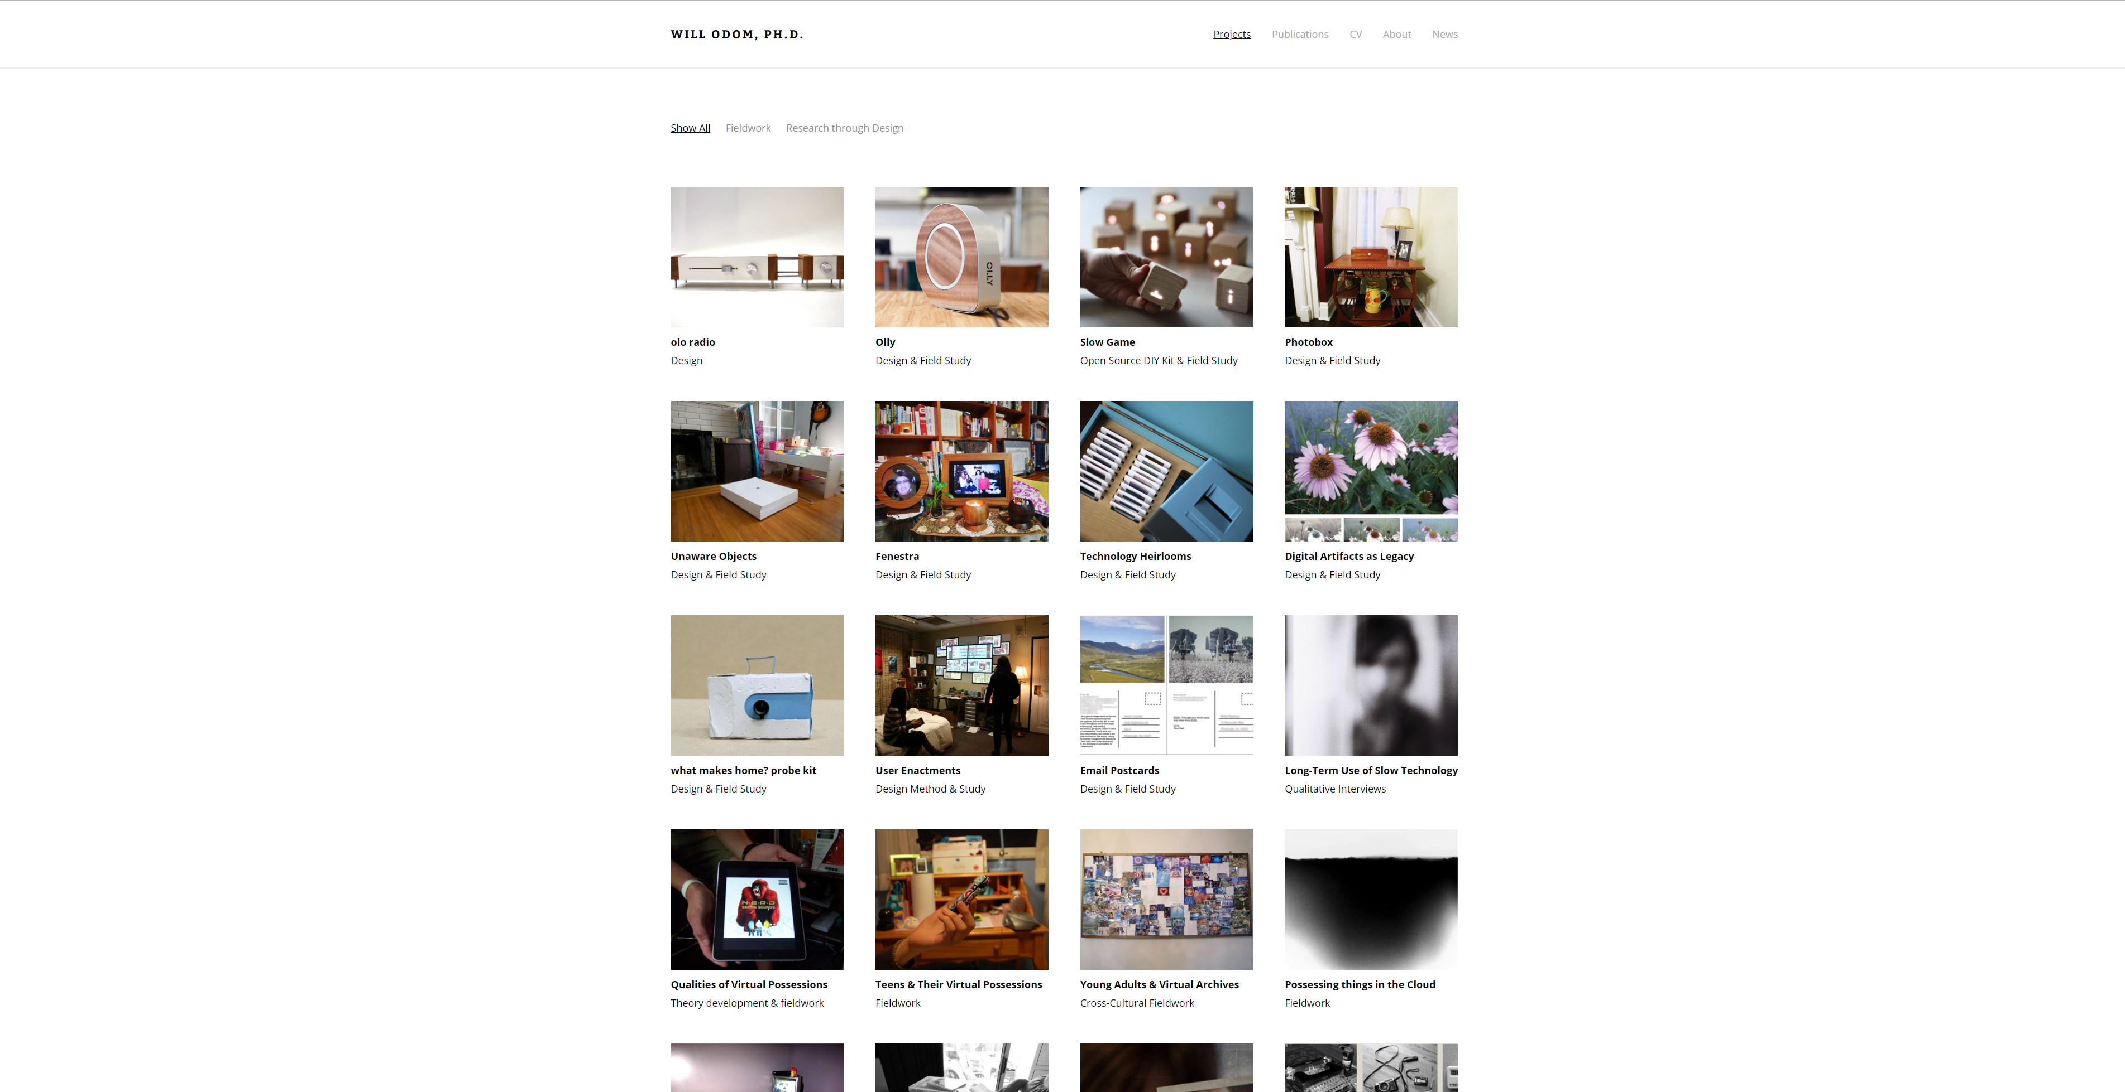
Notes:
http://willodom.com/

Slide 19
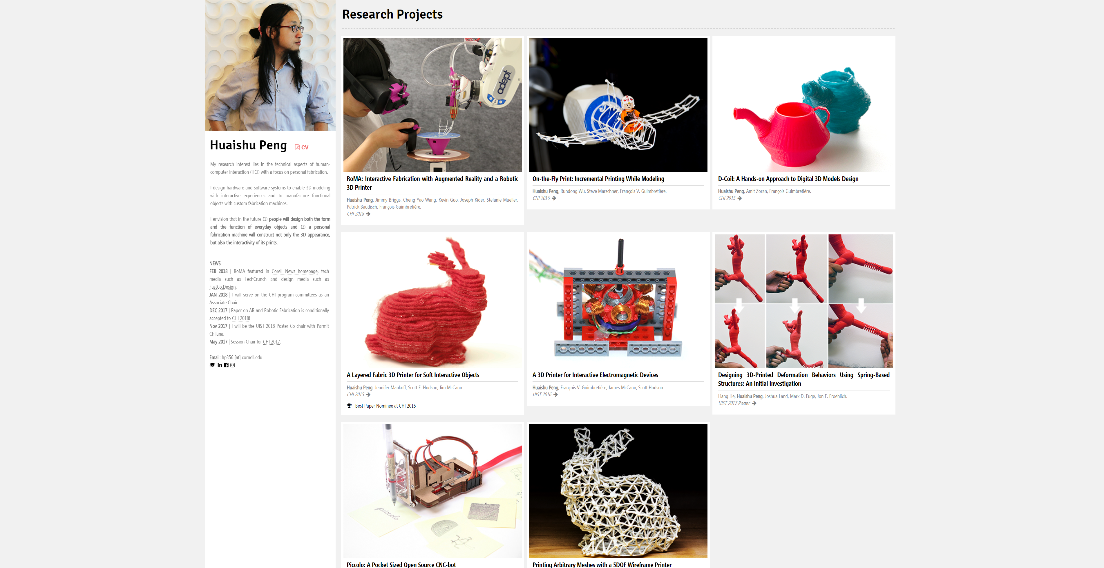

Slide 20
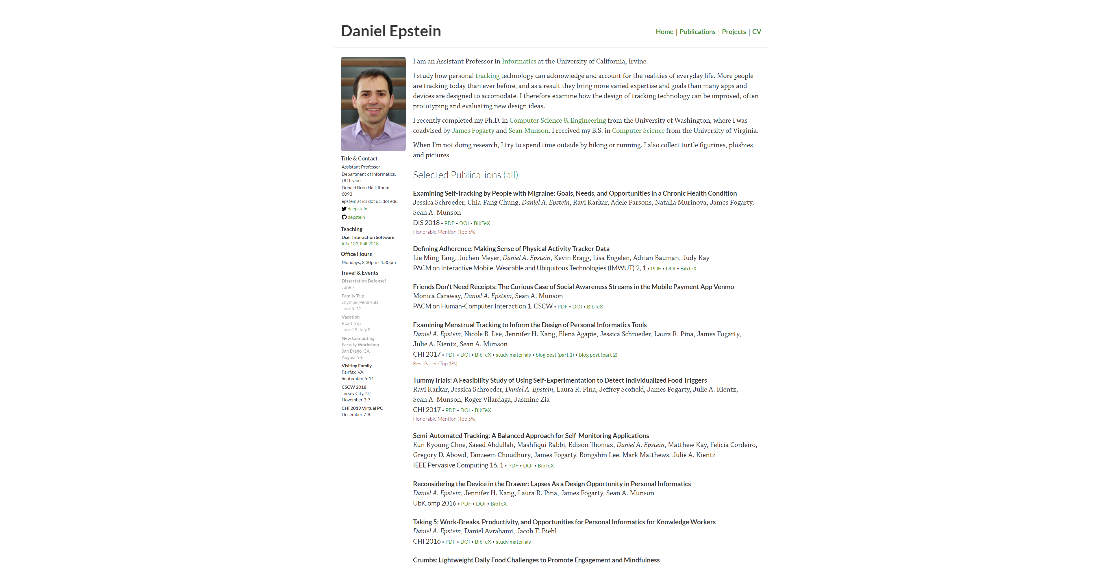

Slide 21
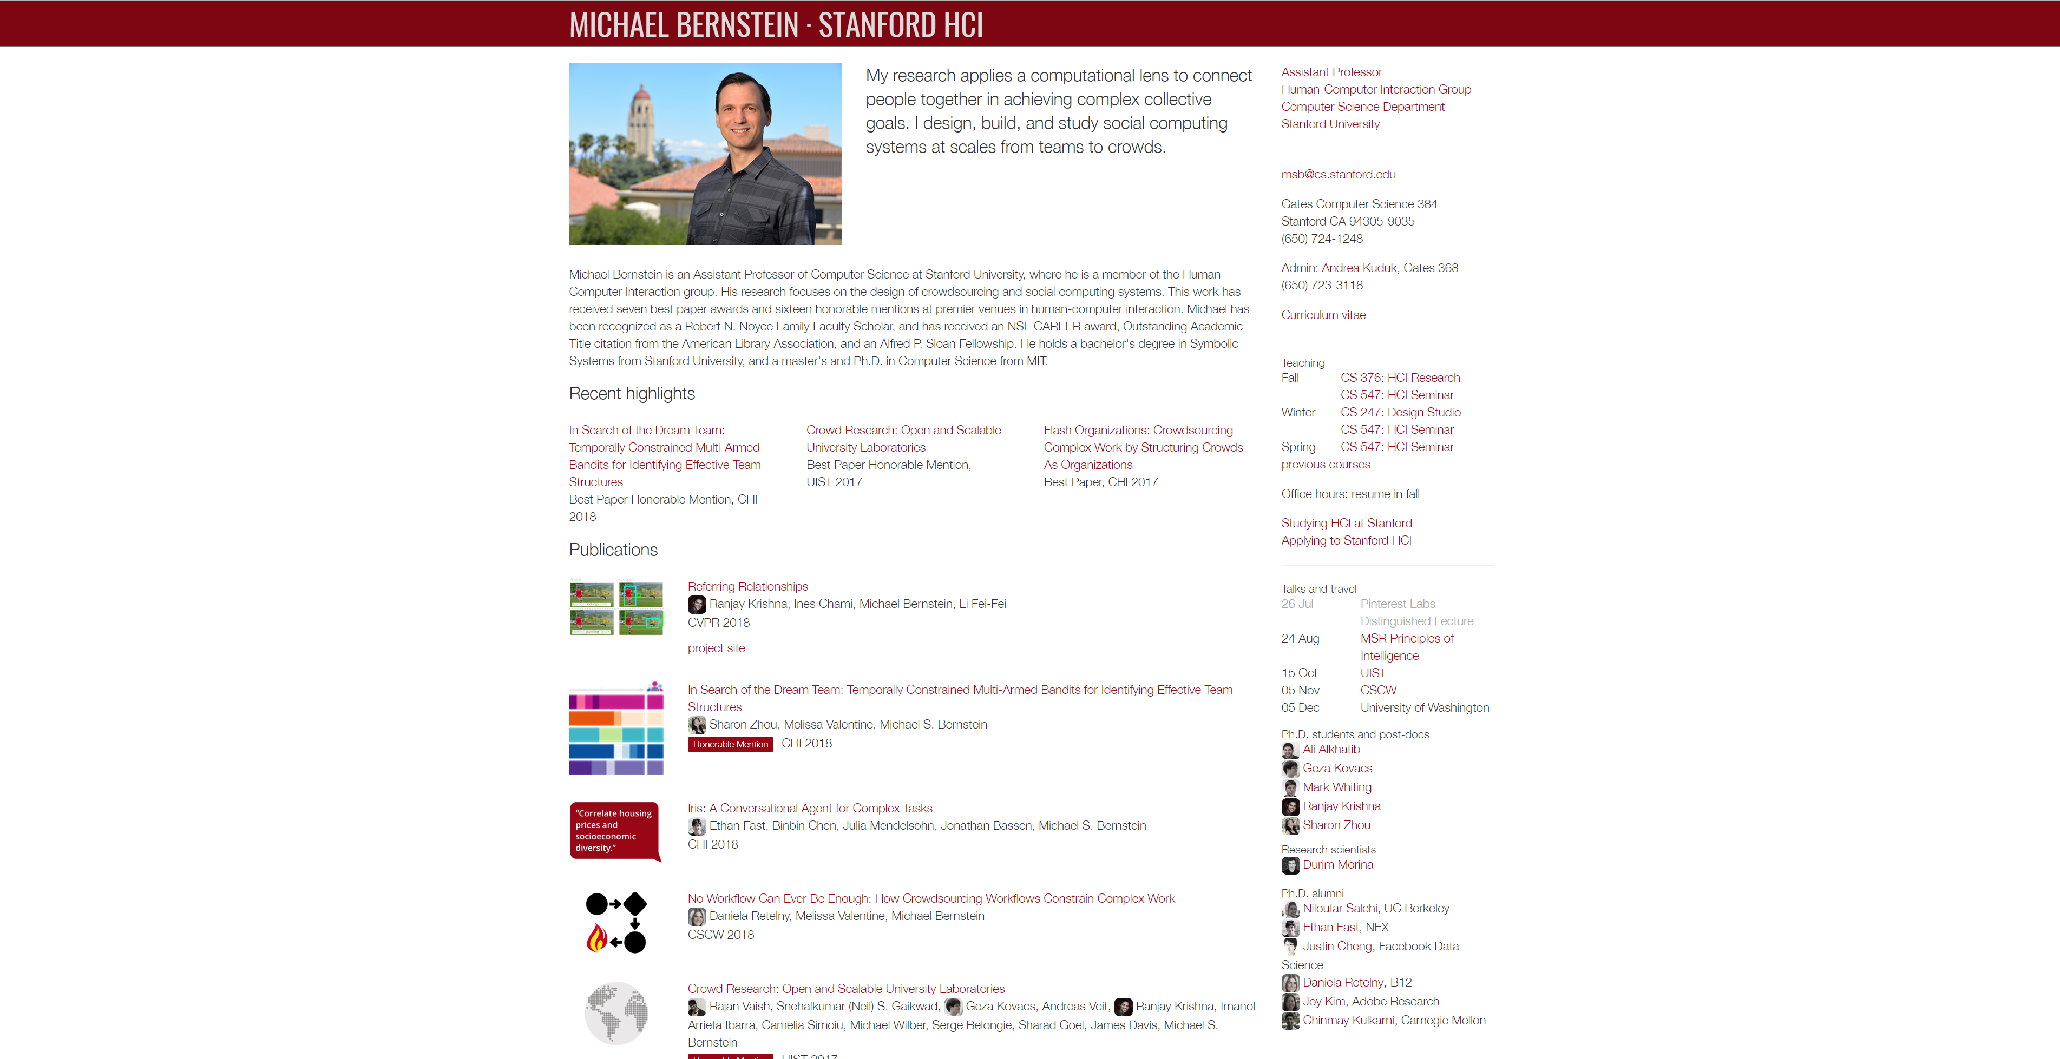
Notes:
http://hci.stanford.edu/msb/

Slide 22
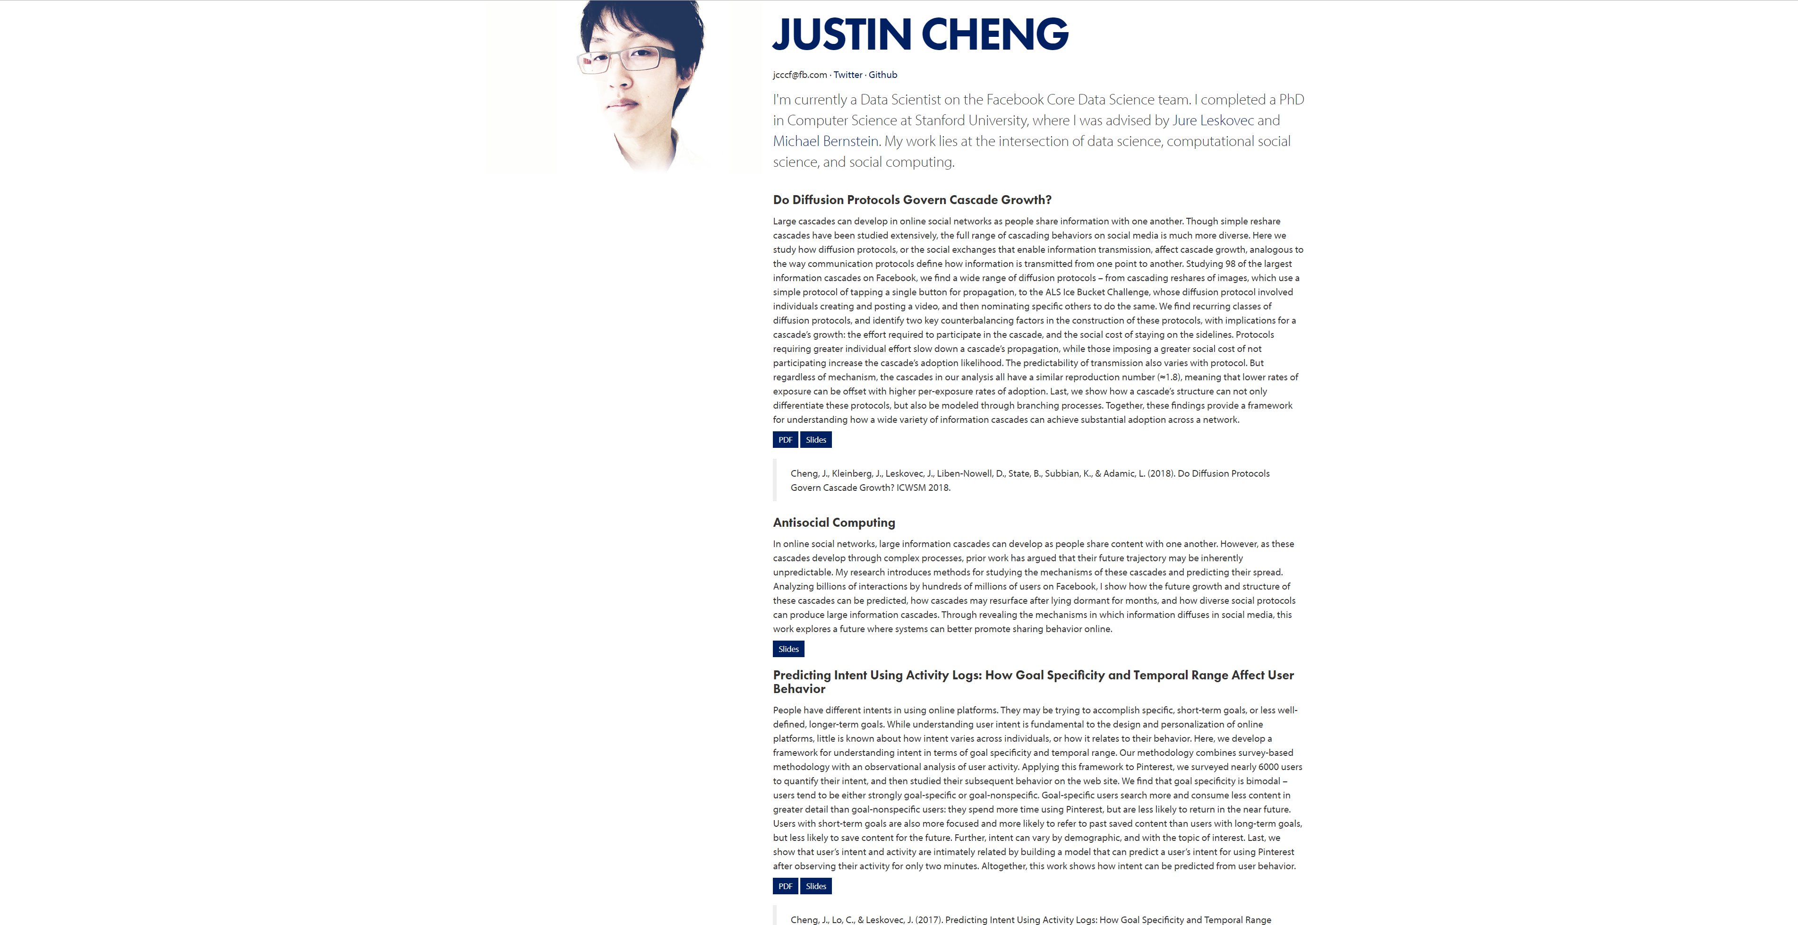
Notes:
https://www.clr3.com/

Slide 23
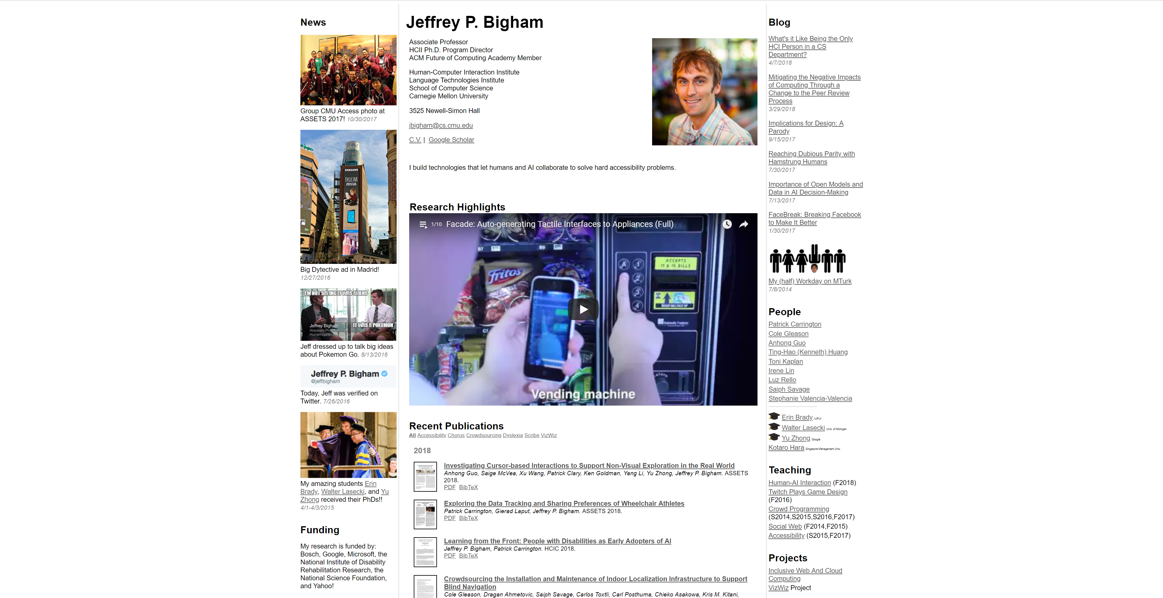
Notes:
https://www.cs.cmu.edu/~jbigham/

Slide 24
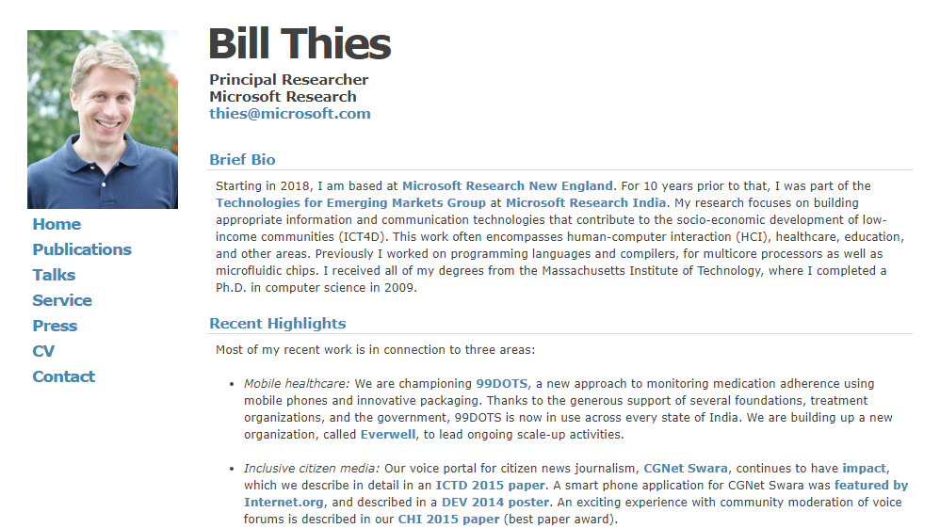

Slide 25
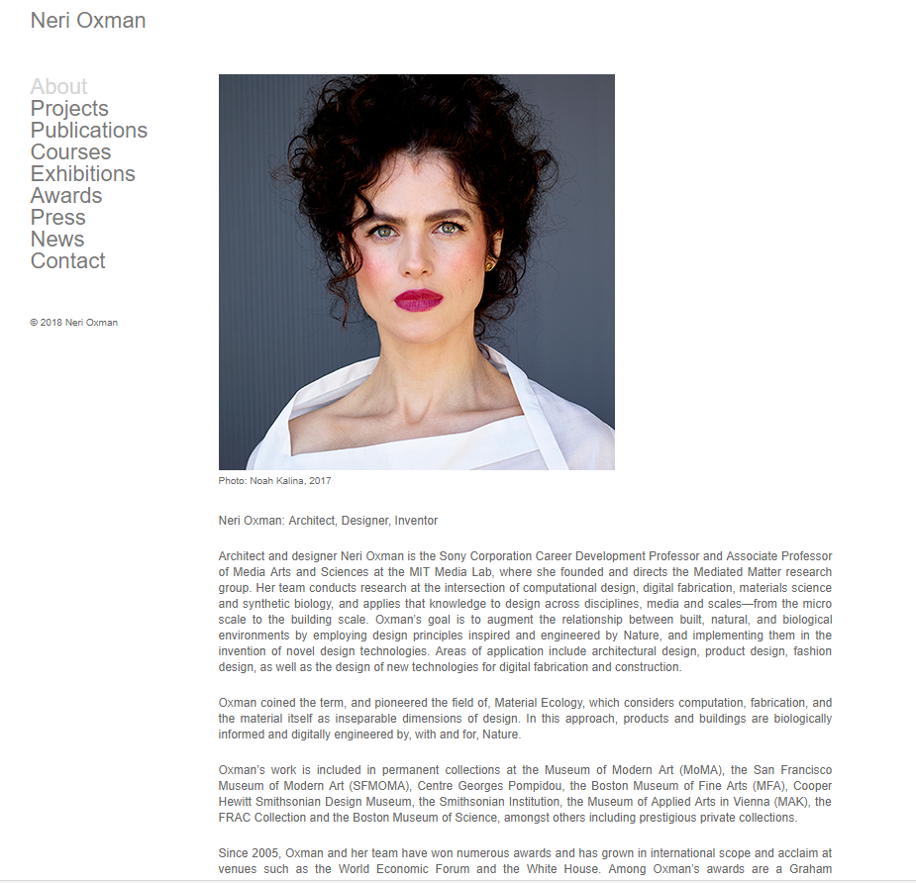

Slide 26
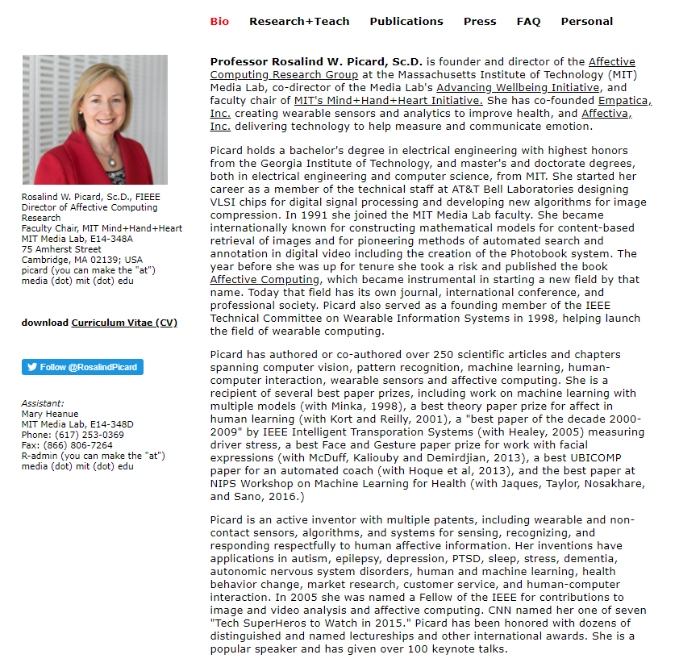

Slide 27

1

Slide 28
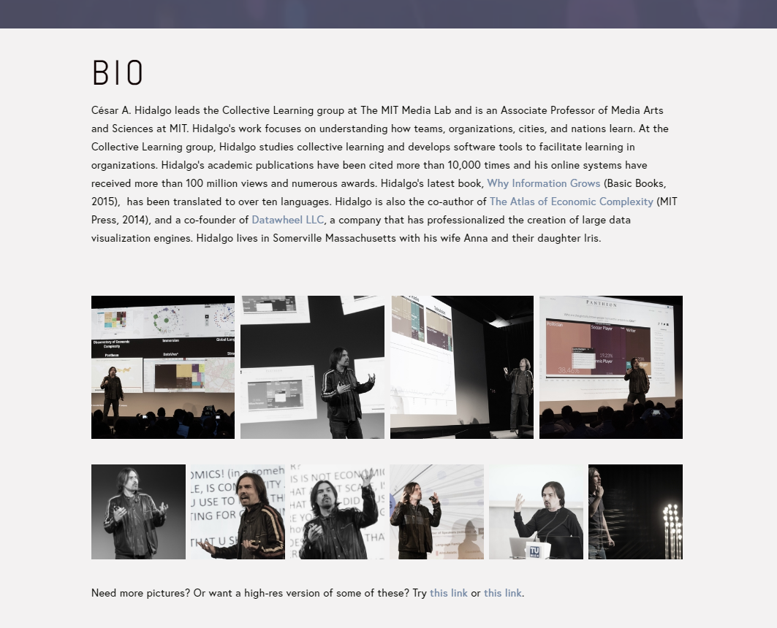
2

Slide 29
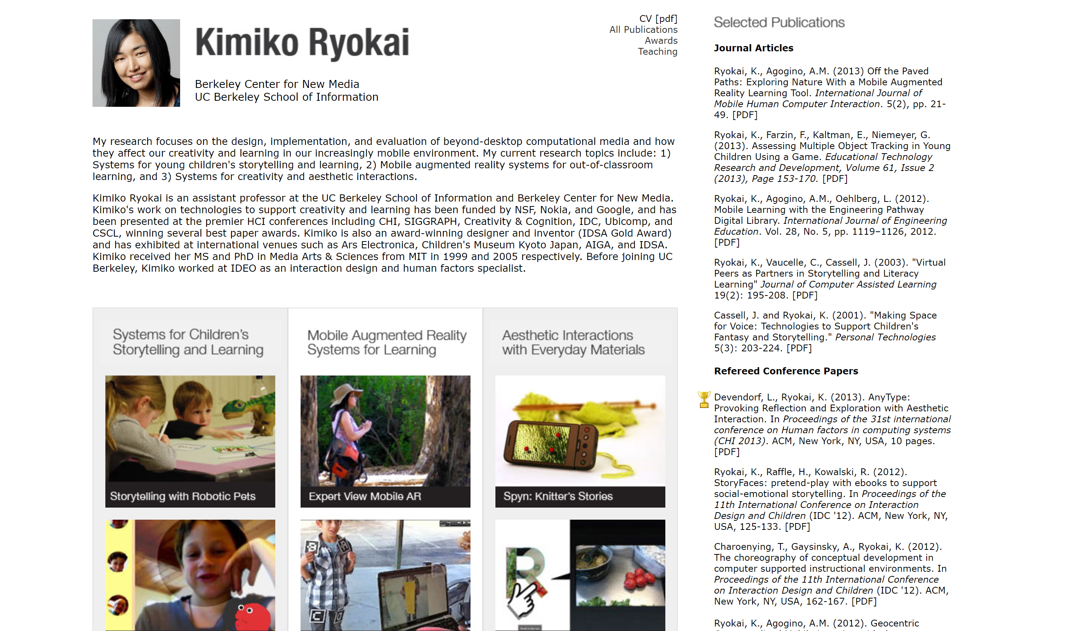

Slide 30


Slide 31
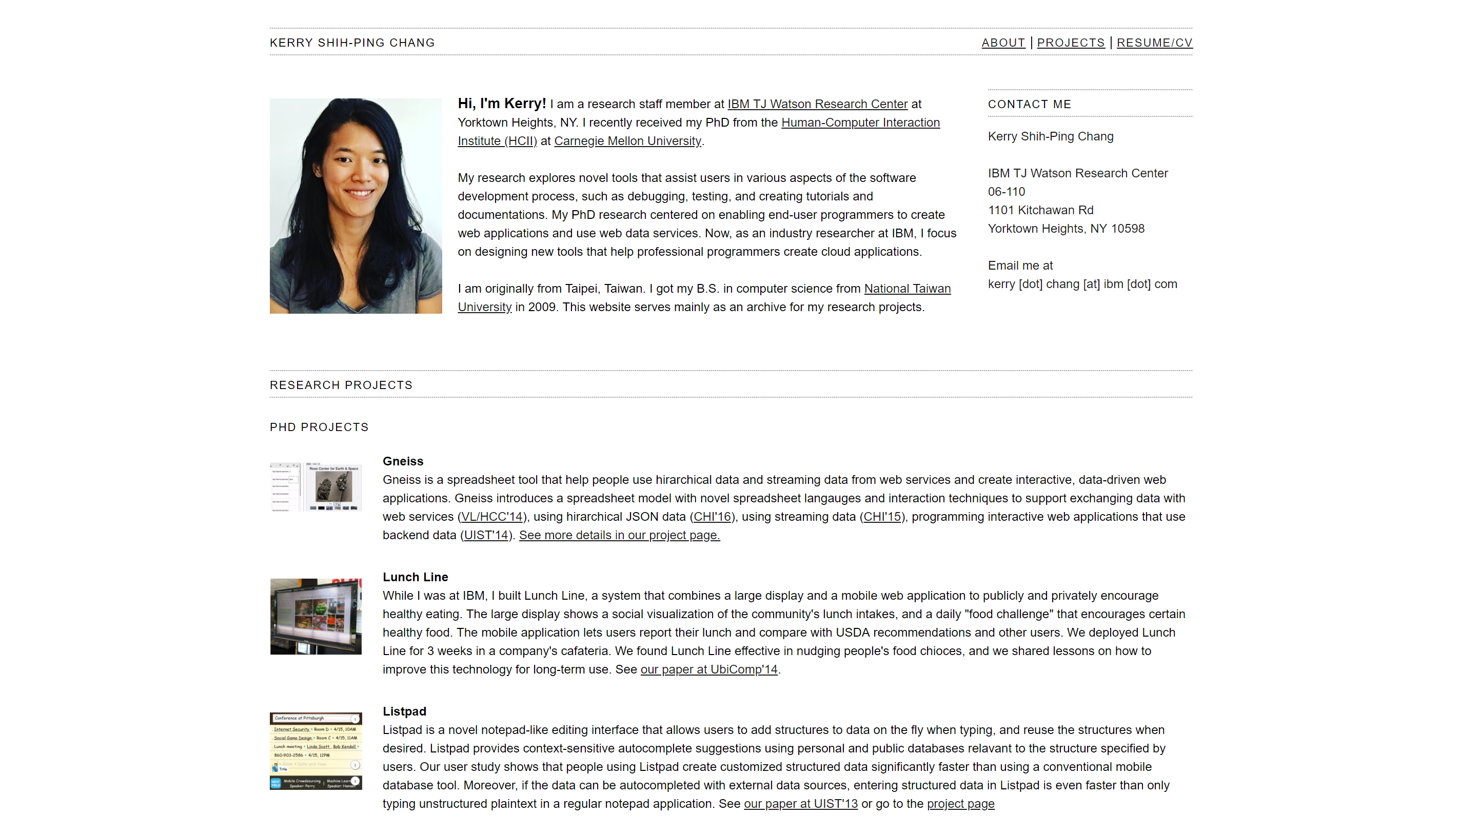

Slide 32
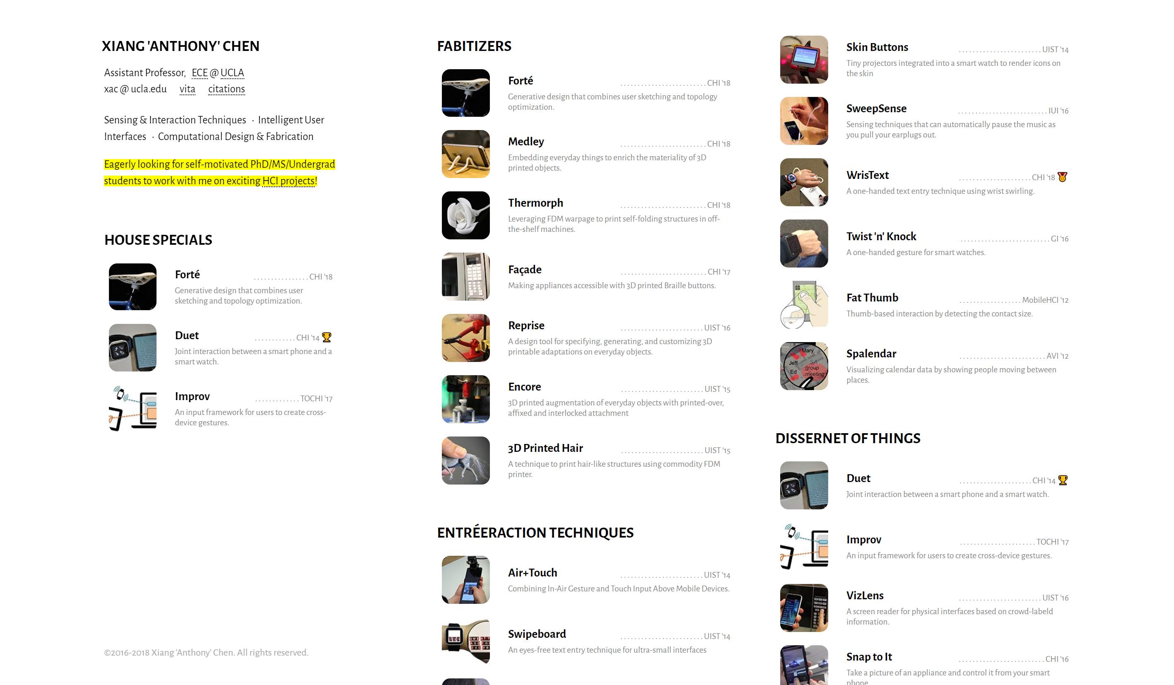

Slide 33

Notes:
http://davidledo.com/index.html

Slide 34
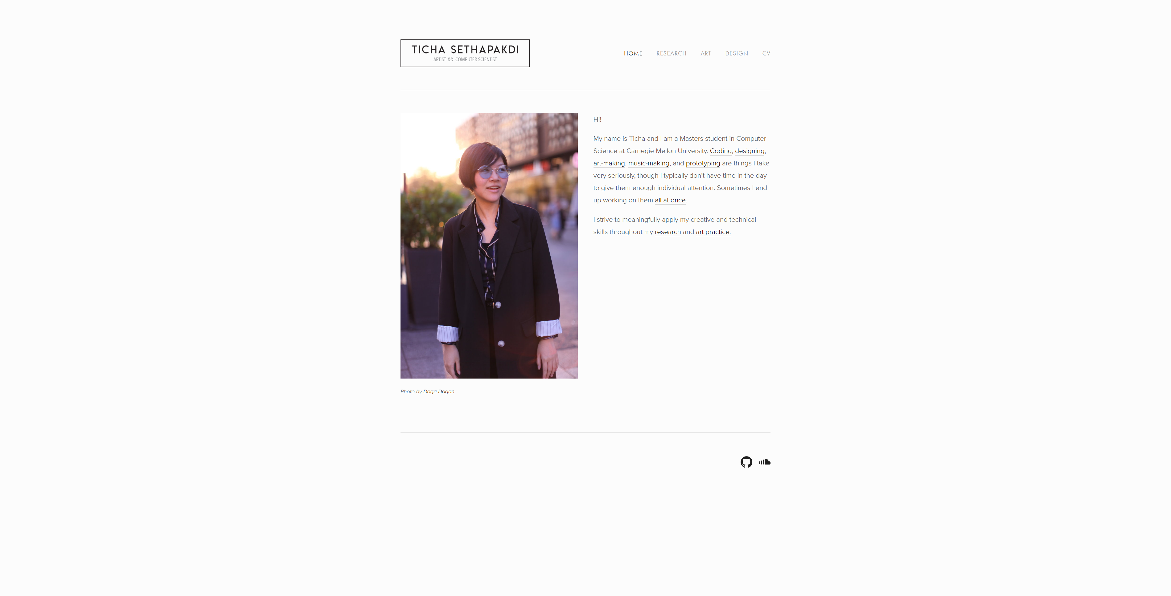
Notes:
www.tichamelody.com

Slide 35


Slide 36

Notes:
And these are animated gifs!

Slide 37
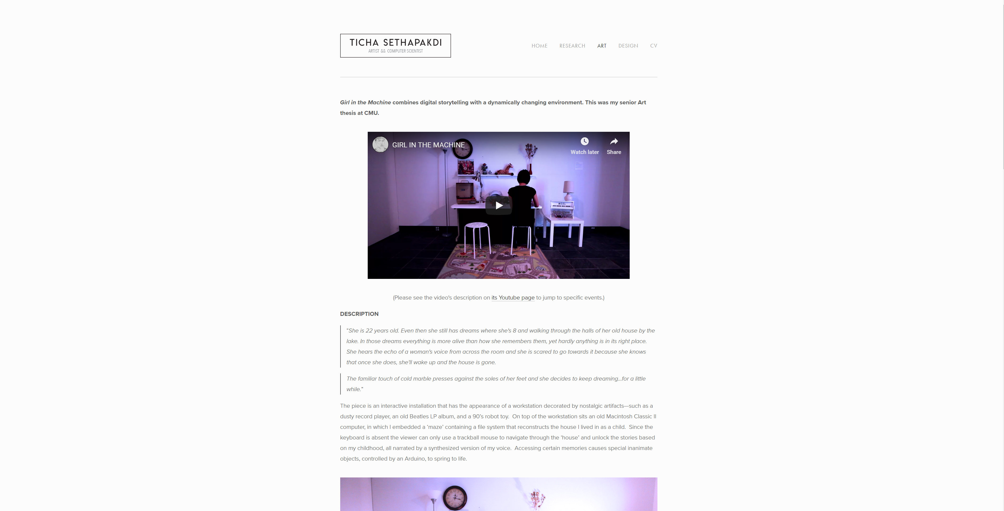

Slide 38
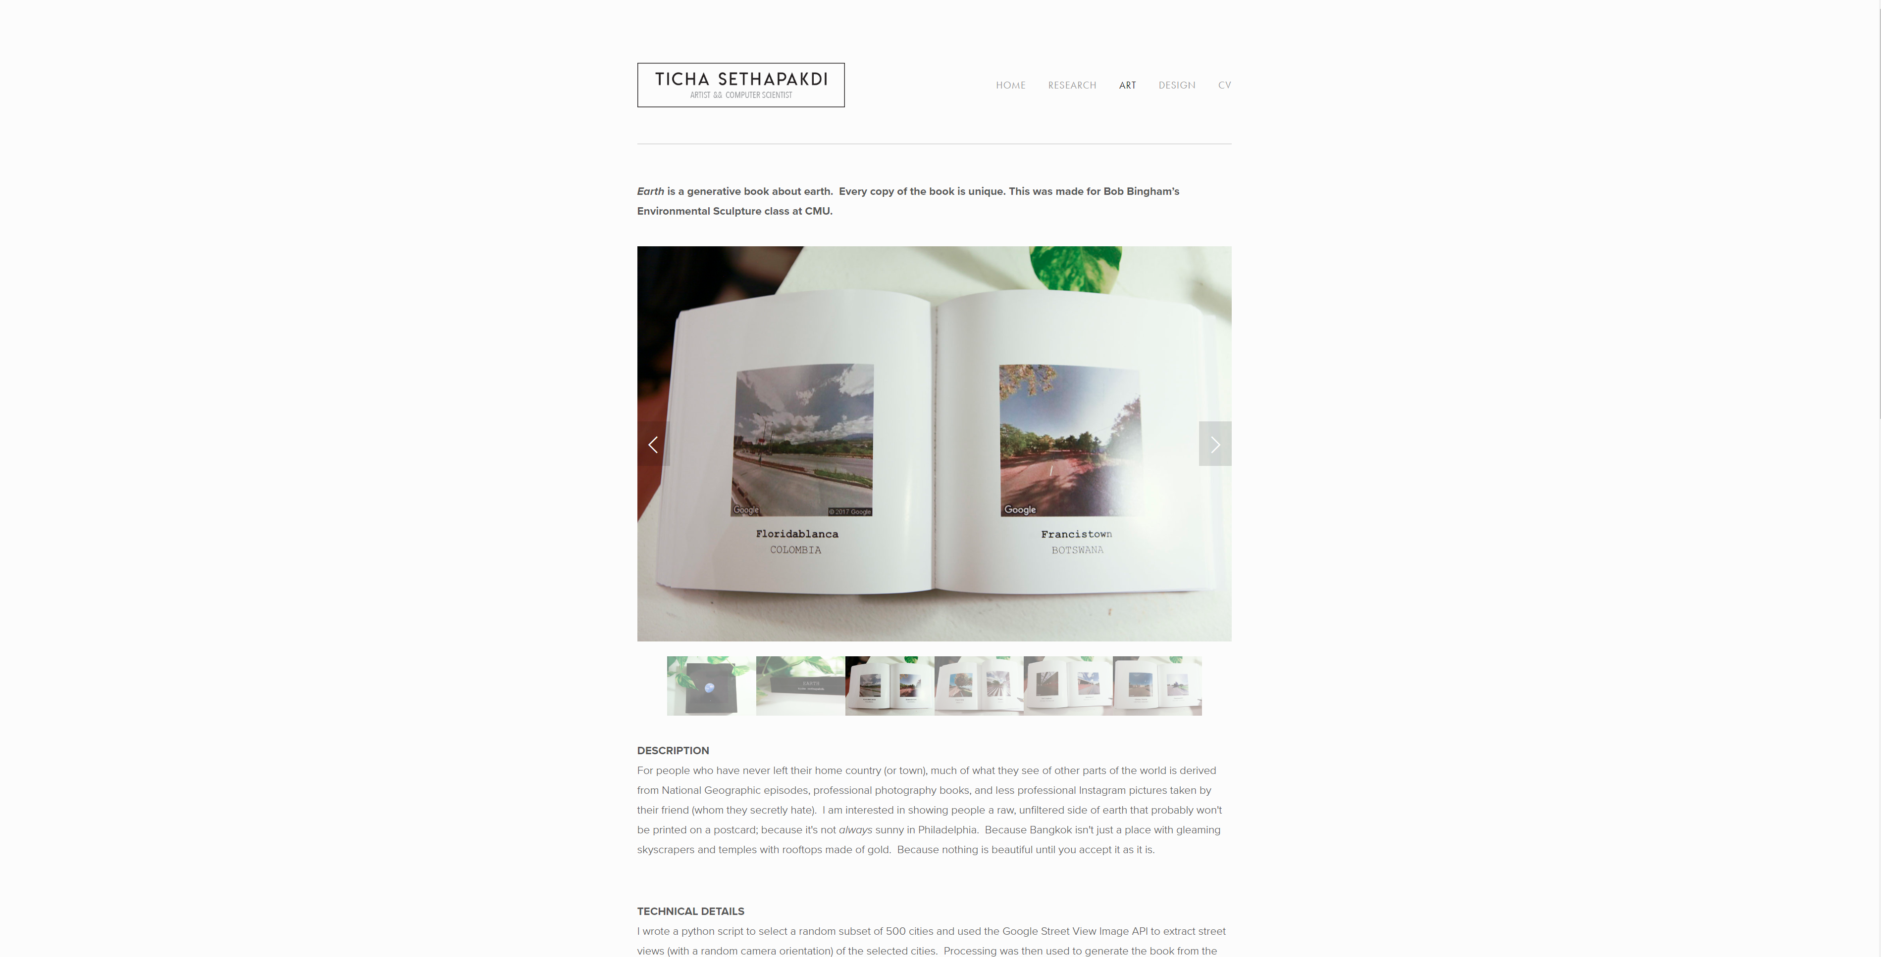

Slide 39
